Slide 2
2023 Fact Pattern
Fact |  |  | Amount
Paid to pastor | A | Cash salary paid (should agree to Benefits Statement and include Moving Expenses paid by the church) | $45,600
 | B | Cash housing allowance (should agree to Benefits Statement) | $12,000
Withheld from pastor’s paycheck | C | UMPIP 403(b) pre-tax contribution by pastor | $4,000
 | D | Pastor’s medical insurance premiums (e.g., enrolled in Family 3 plan) if church has active Internal Revenue Code Section 125 Plan | $4,632
 | E | HSA Amounts withheld from pastor’s paycheck | $2,000
Other significant tax items | F | Parsonage/housing allowance exclusion per resolution | $15,000
 | G | HSA Deposits to pastor’s HSA account by church via West Ohio Conference | $2,000
 | H | Imputed life insurance income in excess of IRS allowance ($100,000 coverage, $50,000 allowed). Imputed income based on employee age, see IRS table in Publication 15-B under Group Term Life section. Example age = 56 yrs | $258

Slide 3
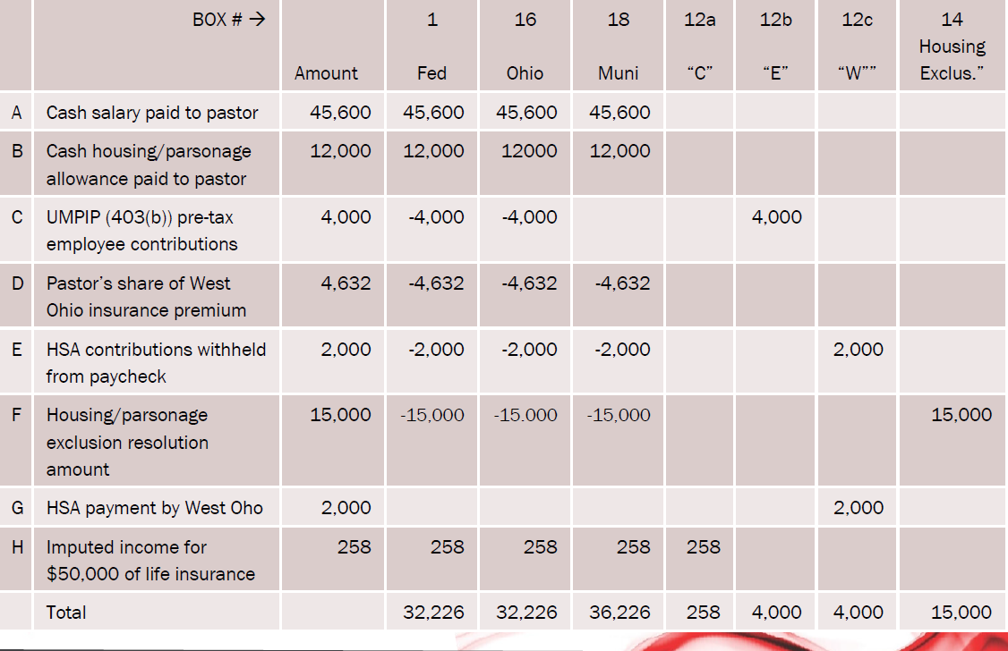
W-2 Worksheet-Taxable Wage Boxes

Slide 4
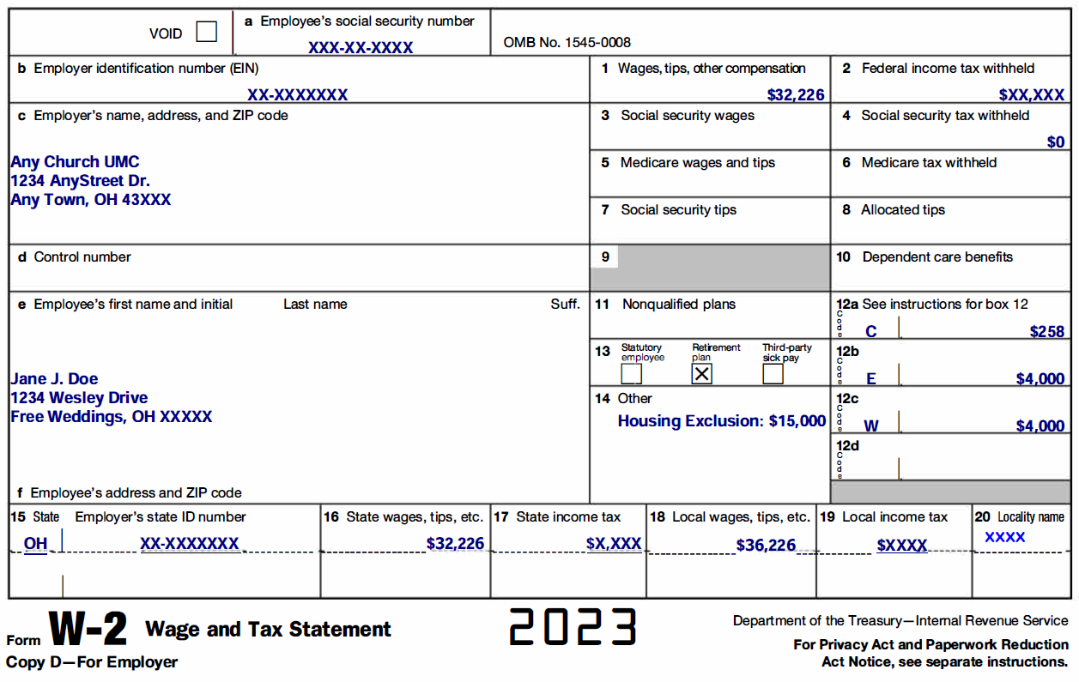
Example 2023 Clergy W-2
School District Income Tax is reported in
Box 19; District name and number in Box 20

